Slide 1
LICENSE PLATE DETECTION
Rana Ertem
Swapnil Kharche

Slide 2
What do we use
Binary image Connected Component algorithm
Machine learning
Segmentation(for licence plate and letters)

Slide 3
TECHNICAL APPROACH
License Plate Detection
Character Segmentation
Character Recognition
Notes:
Rana
License Plate Detection: It is at this stage that the position of the license plate is determined. The input at this stage is an image of the vehicle and the output is the license plate.
Character Segmentation: It’s at this stage the characters on the license plate are mapped out and segmented into individual images.
Character Recognition: This is where we wrap things up. The characters earlier segmented are identified here. We’ll be using machine learning for this.
We have used python, scikit image and scikit learn (scikit learn is a machine learning python library it features various classification, regression and clustering algorithms including support vector machines, )

Slide 4
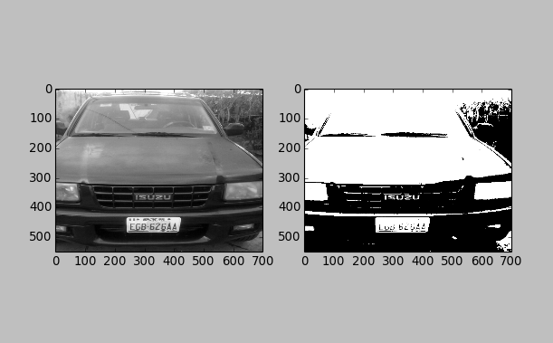
License PLate Detection (Plate Localization)
We first convert the input image to grayscale and then binary.
Notes:
Localization.py binary ve greyscale e döndürüyor
Image processing and machine learning
LPR = License Plate Recognition
Lp detection(position go licence plate)
Character segmentation(characters mapped out)
Character recognition(identify)

Slide 5
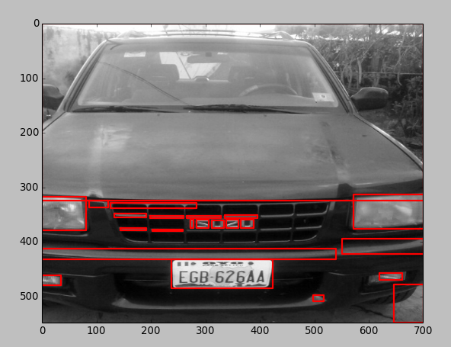
Recongnizing plate from image
Notes:
Connected component analysis = group and label connected regions and foreground
Measure.label = map connected components
regionprops method = return list of all regions and properties ( area, bounding box, labeled)
Patches.Rectange => draw rectangle
r the shape of your license plate

Slide 6
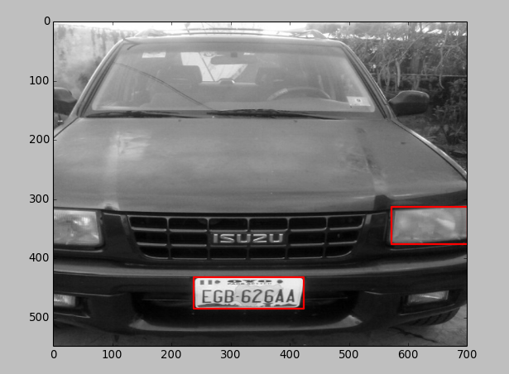
Elimination
Notes:
Still some regions mapped other than licence plate
1)Width is more than weight
2)Rectangular shape
3)Proportion of width of licence plate region to full omg bw 15% and 40%
4)Proportion height bw 8% and 20%
5) patches.Rectangle
6) resize the characters 20x20

Slide 7
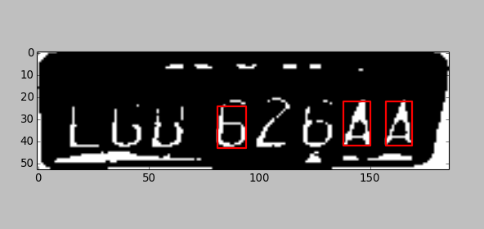

Slide 8
Character Recognition
All we need now is to get a training data set, so we chose a supervised learning classifier, trained a model, tested the model and saw how accurate it is, then used the model for prediction.
We start training our model using a 20x20 dataset, because we’ve already resized each character to that size. We used scikit learn python package for this purpose.
There are several classifiers we can use with each of them having its advantages and disadvantages. We’ll use SVC (support vector classifiers) for this task.
Notes:
-Classifier examples: decision trees, logistic regression and svms
- each character in the training dataset was used to train the svc model. A 4-fold cross validation (1/4 of it for testing
and the remaining 3/4 for the training) was also done to determine how accurate the model is
model was persisted to a file so that predictions can be done without training a model again

Slide 9
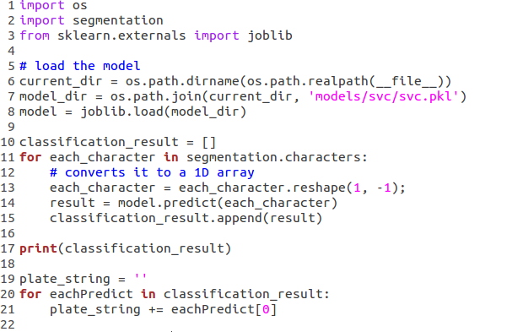
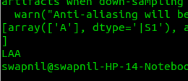
Character Prediction
Notes:
Load the model, use the model to predict each character we got from the segmentation,
Now the characters might be wrongly arranged so we’ll use the variable we used earlier to correctly arrange the letters.

Slide 10
THANK YOU

